Slide 1


By
Florian Rüffer
Mert Ozlutiras
Marvin Rösel
Multi-Stage Document Retrieval and Question Answering Pipeline with BERT
Trivia Question Answering Information Retrieval Project

Slide 2




Overview
Introduction
Document Retrieval
QA
Conclusion
Project Task
Dataset
BM 25
MonoBert
DuoBert
Training
Answering
Evaluation
Summary

Slide 3
Overview
Introduction
Document Retrieval
QA
Conclusion
Project Task
Dataset
BM 25
MonoBert
DuoBert
Training
Answering
Evaluation
Summary

Slide 4









Introduction
Project Goals
Building a pipeline consisting of standard retrieval, neural reranking and question answering
Input: Question + Documents
Standard Doc Retrieval
Reranking
QA

Slide 5


Introduction
The dataset
62.000 triples in the wikipedia-train set of TriviaQA
74.000 Text documents from wikipedia
Each question has some (most of the time between 1 and 5) related documents
In these documents the answer to the question can be found
70/30 train-test split
Question
Answer
Relevant Doc

Slide 6
Introduction
Pipeline
BM25+
d₁
d₂
d₃
.
.
.
.
d₅₀
monoBERT
d₃₂
d₁₁
d₄₆
d₃
d₂₇
duoBERT
d₃₂
d₄₆
d₂₇
d₁₁
d₃
Question Answering
Answer
Question
Corpus

Slide 7
Overview
Introduction
Document Retrieval
QA
Conclusion
Project Task
Dataset
BM 25
MonoBert
DuoBert
Training
Answering
Evaluation
Summary

Slide 8
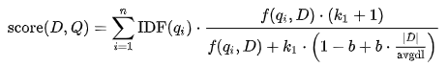
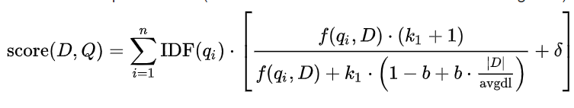
Document Retrieval
BM25
What is BM25?
Bag-of-words retrieval function -> probabilistic retrieval
Assigns a relevance score for each document given a query -> ranked retrieval
Improvements to BM25
BM25+ -> uses an additional parameter delta, which is added to the second part of the equation
https://en.wikipedia.org/wiki/Okapi_BM25

Slide 9
Document Retrieval
BM25 - Preprocessing
Using a traditional text preprocessing pipeline
Remove Punctuation
Lowercase
Stopword Removal
Stemming
NOT Applied on monoBERT or duoBERT!

Slide 10
Document Retrieval
BM25 – Evaluation
 | MP@K |  |  | MAP@K
 | BM11 | BM25 | BM25+ | BM11 | BM25 | BM25+
K = 1 | 0.47 | 0.49 | 0.52 | 0.47 | 0.49 | 0.52
K = 2 | 0.34 | 0.36 | 0.38 | 0.54 | 0.56 | 0.59
K = 3 | 0.28 | 0.28 | 0.30 | 0.56 | 0.58 | 0.6
K = 4 | 0.23 | 0.23 | 0.25 | 0.56 | 0.58 | 0.61
K = 5 | 0.20 | 0.20 | 0.21 | 0.57 | 0.58 | 0.61
R-Prec | 0.40 | 0.42 | 0.44
AR-Prec | 0.51 | 0.53 | 0.56

Slide 11
Document Retrieval
Pipeline
BM25+
d₁
d₂
d₃
.
.
.
.
d₅₀
monoBERT
d₃₂
d₁₁
d₄₆
d₃
d₂₇
duoBERT
d₃₂
d₄₆
d₂₇
d₁₁
d₃
Question Answering
Answer
Question
Corpus

Slide 12

Document Retrieval
monoBERT – Architecture and Training
[CLS] Emb
Silu Activation
Architecture:
DistilRoberta
Linear + Dropout
Linear
Sigmoid
Training:
[CLS] Q [SEP] D_{i} [SEP]
Score showing how relevant D_{i} for question Q
Question Q
Tokenize
Question + Document
Document (D_{i})
Label rel(Q, Di)
Compare predicted and correct answer
Binary Cross-entropy loss
Improve through backpropagation

Slide 13
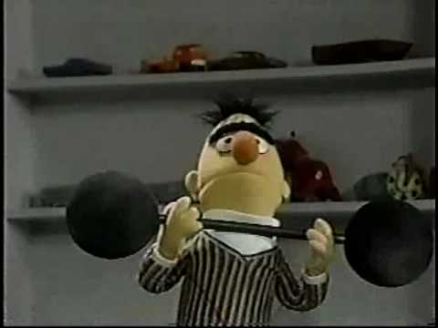
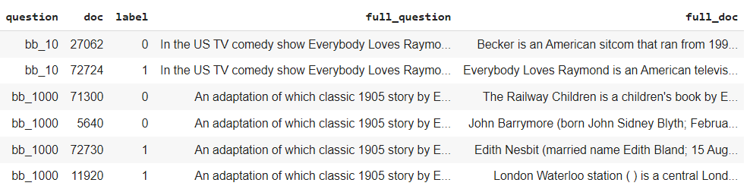
Document Retrieval
monoBERT – Data Preparation
All relevant documents for question Q: “k” of them
“k” irrelevant documents that are ranked high by BM25+ added to training set
More difficult to discriminate
Push BERT (distil-roberta) for better training
Equally distributed relevant and non-relevant documents
1 Relevant doc – 1 Irrelevant
2 Relevant docs – 2 Irrelevant

Slide 14
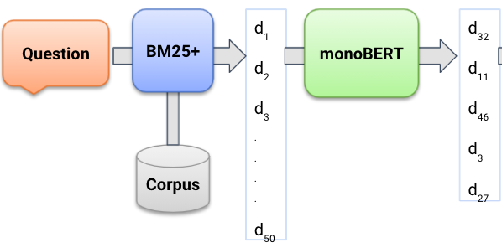
Document Retrieval
monoBERT – Inference
Input: Question Q + top 50 documents from BM25+
Pointwise score s_{i} per document is computed: s₁, s₂, s₃… s₅₀
5-highest s_{i} ranked and returned

Slide 15
Document Retrieval
monoBERT – Evaluation
 | MP@K |  | MAP@K
 | monoBERT | BM25+ | monoBERT | BM25+
K = 1 | 0.57 | 0.52 | 0.57 | 0.52
K = 2 | 0.49 | 0.38 | 0.67 | 0.59
K = 3 | 0.37 | 0.30 | 0.67 | 0.6
K = 4 | 0.32 | 0.25 | 0.67 | 0.61
K = 5 | 0.27 | 0.21 | 0.67 | 0.61
R-Prec | 0.46 | 0.44
AR-Prec | 0.61 | 0.56

Slide 16
Document Retrieval
Pipeline
BM25+
d₁
d₂
d₃
.
.
.
.
d₅₀
monoBERT
d₃₂
d₁₁
d₄₆
d₃
d₂₇
duoBERT
d₃₂
d₄₆
d₂₇
d₁₁
d₃
Question Answering
Answer
Question
Corpus

Slide 17
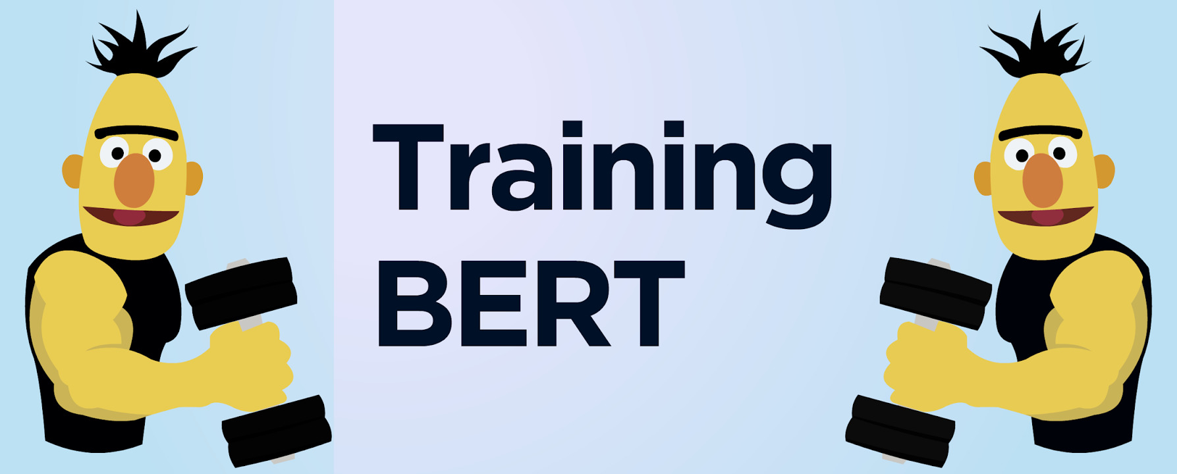
Document Retrieval
duoBERT – Training and Architecture
Architecture: Same as monoBERT
Training:
[CLS] Q [SEP] D_{i} [SEP] D_{j} [SEP]
Question
Score showing probability D_{i} more relevant than D_{j}
Tokenize
Question + D_{i} + D_{j}
Document (D_{i})
Document (D_{j})
Question: max tokens
Docs: (512-question) shared equally
Label rel(Q, Di, Dj)
Compare predicted and correct answer
Binary Cross-entropy loss
Improve through backpropagation

Slide 18
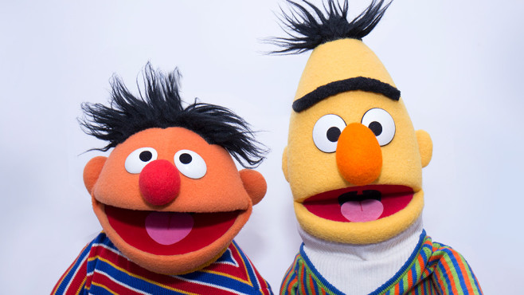
Document Retrieval
duoBERT – Dataset preparation
Questions + relevant document pairs taken
Cross product with irrelevant documents
Given score 1
Combinations other way around also added
Doc_x | Doc_y | Score
Relevant Document | Irrelevant Document | 1
Irrelevant Document | Relevant Document | 0

Slide 19
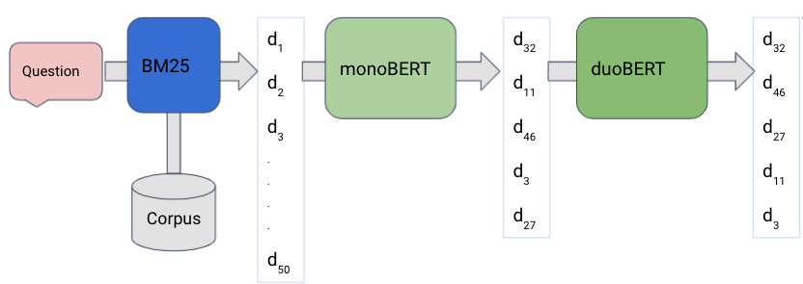
Document Retrieval
duoBERT – Inference
Input: Question Q + 5 documents from monoBERT
Pairwise score per document is computed: S₁, S₂, S₃, S₄, S₅
Each document is compared against other documents
4 scores per document summed up to get respective S_{i}
S_{i}: pairwise agreement that candidate D_{i} is more relevant than the rest of the candidates
Documents re-ranked by respective S_{i}

Slide 20
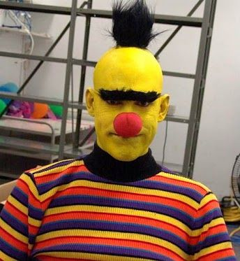
Document Retrieval
duoBERT – Evaluation
Different architectures explored (CNNs etc.)
No improvement over the results from monoBERT
Worse than monoBERT
Self critics:
Dataset not rich enough?
Float scores instead of only 0s and 1s? But, how?
BERT failed

Slide 21
Overview
Introduction
Document Retrieval
QA
Conclusion
Project Task
Dataset
BM 25
MonoBert
DuoBert
Training
Answering
Evaluation
Summary

Slide 22
Document Retrieval
Question Answering
Training:
Question
Tokenize Question + Text
Find bucket with answer
Text
Answer
Predict the answer
Compare predicted and correct answer
Improve through backpropagation

Slide 23
Document Retrieval
Question Answering
Training:
Question
Tokenize Question + Text
Find bucket with answer
Text
Answer
Predict the answer
Compare predicted and correct answer
Improve through backpropagation

Slide 24
Document Retrieval
Question Answering
Training:
Question
Tokenize Question + Text
Find bucket with answer
Text
Answer
Predict the answer
Compare predicted and correct answer
Improve through backpropagation

Slide 25
Document Retrieval
Question Answering
Training:
Question
Tokenize Question + Text
Find bucket with answer
Text
Answer
Predict the answer
Compare predicted and correct answer
Improve through backpropagation

Slide 26
Document Retrieval
Question Answering
Training:
Question
Tokenize Question + Text
Find bucket with answer
Text
Answer
Predict the answer
Compare predicted and correct answer
Improve through backpropagation

Slide 27
Document Retrieval
Question Answering
Training:
Question
Tokenize Question + Text
Find bucket with answer
Text
Answer
Predict the answer
Compare predicted and correct answer
Improve through backpropagation

Slide 28
Document Retrieval
Question Answering
Answering:
If more tokens available
Question
Tokenize Question + Text
Predict 512 token scores
Text
If all tokens predicted
Concatenate all scores
Search max values
Return decoded values

Slide 29
Document Retrieval
Question Answering
Answering:
If more tokens available
Question
Tokenize Question + Text
Predict 512 token scores
Text
If all tokens predicted
Concatenate all scores
Search max values
Return decoded values

Slide 30
Document Retrieval
Question Answering
Answering:
If more tokens available
Question
Tokenize Question + Text
Predict 512 token scores
Text
If all tokens predicted
Concatenate all scores
Search max values
Return decoded values

Slide 31
Document Retrieval
Question Answering
Answering:
If more tokens available
Question
Tokenize Question + Text
Predict 512 token scores
Text
If all tokens predicted
Concatenate all scores
Search max values
Return decoded values

Slide 32
Document Retrieval
Question Answering
Answering:
If more tokens available
Question
Tokenize Question + Text
Predict 512 token scores
Text
If all tokens predicted
Concatenate all scores
Search max values
Return decoded values

Slide 33
Document Retrieval
Question Answering
Answering:
If more tokens available
Question
Tokenize Question + Text
Predict 512 token scores
Text
If all tokens predicted
Concatenate all scores
Search max values
Return decoded values

Slide 34
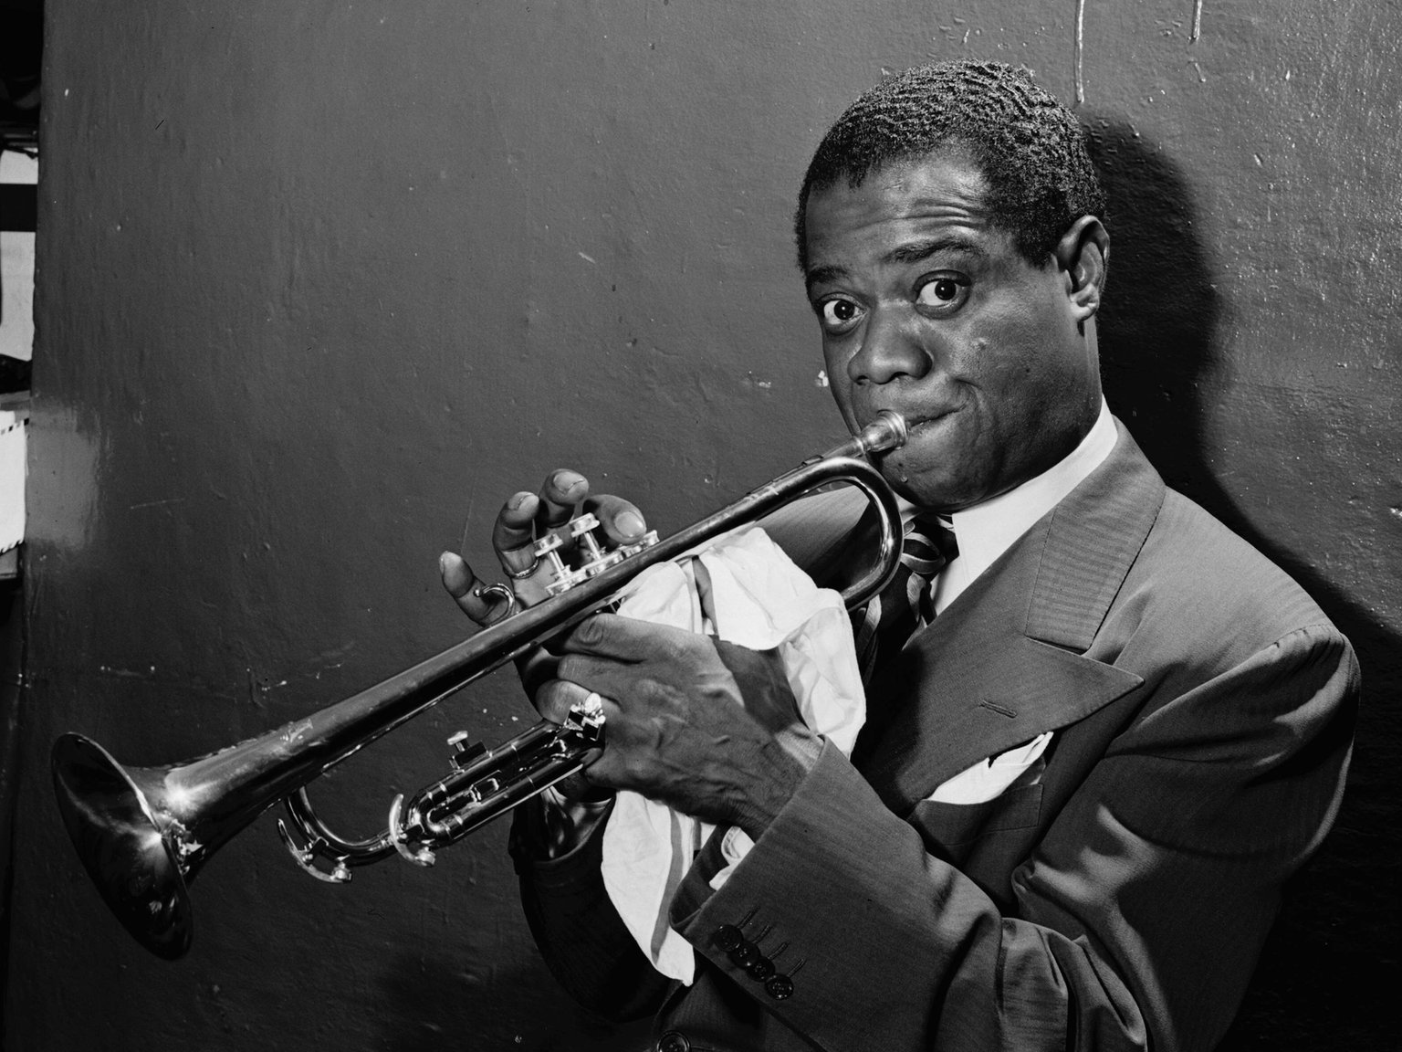
Document Retrieval
Question Answering
Correct Answer:
Question: “Which musician was known as ‘Satchmo’?”
Predicted Answer: “louis armstrong”
Given Answer: “louis armstrong”

Slide 35
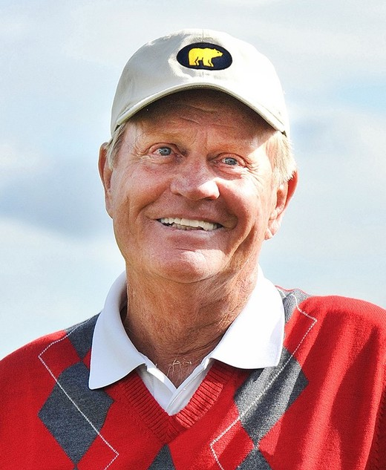
Document Retrieval
Question Answering
Partly-Correct Answer:
Question: “Which golfer Jack was nicknamed ‘The Golden Bear’?”
Predicted Answer: “jack william nicklaus”
Given Answer: “jack nicklaus”

Slide 36
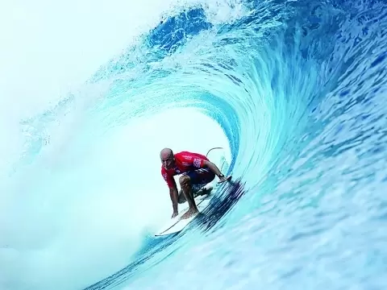
Document Retrieval
Question Answering
Partly-Correct Answer:
Question: “American ‘Kelly Slater’ is best known for which sport?”
Predicted Answer: surf
Given Answer: surfing

Slide 37
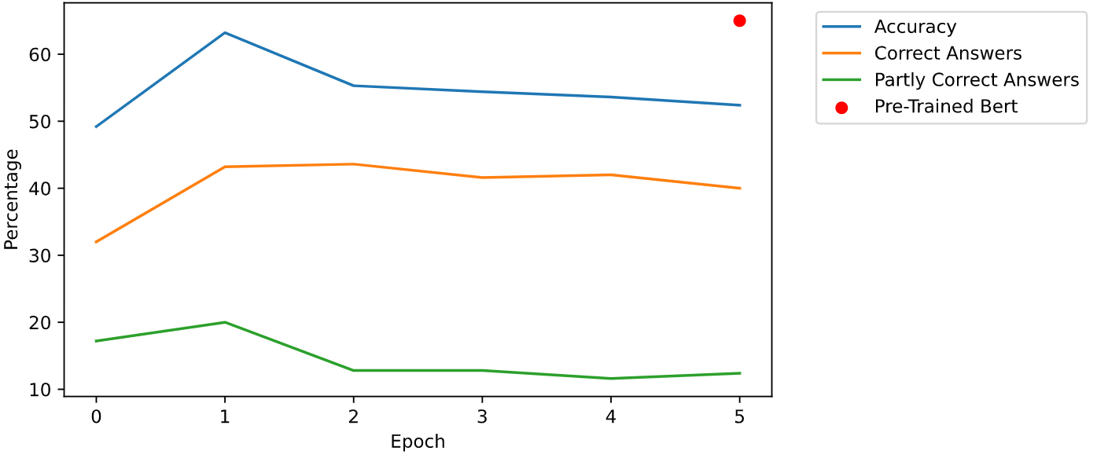
Document Retrieval
Question Answering – Test set evaluation

Slide 38
Overview
Introduction
Document Retrieval
QA
Conclusion
Project Task
Dataset
BM 25
MonoBert
DuoBert
Training
Answering
Evaluation
Summary

Slide 39
Conclusion
Summary
Building a pipeline consisting of standard retrieval, neural reranking and question answering
Input: Question + Documents
Standard Doc Retrieval
Reranking
QA

Slide 40
References
Louis Armstrong: https://www1.wdr.de/radio/wdr3/programm/sendungen/wdr3-jazz-world/louis-armstrong-106~_v-HintergrundL.jpg
Jack Nicklaus: https://wsbaws-websitefs-prod.s3.amazonaws.com/2018/11/08/11/52/06/65b4301c-b495-4cf0-ba65-58a32451e063/Nicklaus_Jack_HS.jpg
Kelly Slater: https://www.theportugalnews.com/uploads/news/medium/Page25-Kelly-Slater-surfing.webp

